Slide 1
Research into the experiences of unaccompanied foster children
Johan Vanderfaeillie, Lore Van Den Daele, Lenny Trogh & Frank Van Holen

Slide 2
content
Context
Well-being of unaccompanied minor refugees
The concept of resilience and resilience in unaccompanied minor refugees
Research questions
Research methods
Procedure
Measures
Participants
Results
Conclusions and discussion
Limitations
Recommendations

Slide 3
Context
Each day more than 8 unaccompanied minor refugees (UMR) arrive in Belgium
The number UMR that ask for asylum is high:
2014: 804
2015: 2548
2016: 1021
Unaccompanied minor refugees are:
Minors (< 18 years)
Not accompanied by someone who exercises parental authority or guardianship
Is citizen of non-EER country
In addition:
Have applied for asylum
Stay unauthorized in the country
Custody Agency (dienst Voogdij) has identified the minor as UMR
Some UMR do not apply for asylum. Their number is unknown
UMR are increasingly cared for in Foster Care in Flanders
However, only a small proportion (331 of 1920 or 17,2% in 2017)
74 UMR in NON-kinship foster care (having sometimes the same cultural background) and 257 in kinship foster care families that have the same cultural background

Slide 4
Context
Tasks of the Custody Agency (dienst Voogdij)
Belongs to the Federal Agency Justice
Takes the child in het custody
Identifies the child as an URM
Appoints a guardian
Coordinates several services taking care of the URM
Responsible for a long lasting solution
Tasks of guardian
Representing the URM
Support the URM during all kinds of procedures
Seeking support from an attorney
In addition:
Responsible for education, psychological support, medical care and housing
Responsible for the living context: foster care, residential care
Protecting political, cultural and religious rights
Administer money and goods of URM
Looking for lasting situation (for example looking for birth parents)
Reporting to Juvenile Court

Slide 5
Context
URM are entitled to extra protection
Extra protection is offered by exceptional residence procedure
Aim of the exceptional residence procedure is looking for long lasting solution
Return to birth parents in the country where they stay legally
Return to country where the URM can stay legally
Permission to stay in Belgium
During the period of the exceptional residence procedure, the URM receives residence permit
Provisional residence stay (attestation of immatriculation; attest van immatriculatie)
When long lasting solution is Belgium, the URM receives a temporary authorization of stay (3 years; after 3 years right of stay of unlimited duration)
Other residence procedures
Seeking asylum
Victim of traffic of humans
Humanitarian regularization
Medical regularization

Slide 6
Context
Phases of stay
At arrival: stay in observation and orientation Centre (max 4 weeks) with main goal the identification of the URM as URM
Relocated to collective shelter during provisional stay
If long lasting solution is Belgium
Living independently
Living in collective local initiatives
Living in a foster family

Slide 7
Well-being of unaccompanied minor refugees (1)
Well-being is determined by events: pre-migration, migration and post-migration
Pre-migration
Loss of beloved, loss of family, life-threatening events, exposure to war, torture, …
Abuse (Physical, Sexual, …)
Feelings of insecurity and danger (Vervliet et al., 2014)
Migration
Separation from parents and family
Disruption from school or work
Fear and abuse during journey, unsafe living conditions, uncertainty of place to live
Living in refugee camps
Post-migration
Insecurity about future (Zijlstra et al., 2014)
Stress and insecurity associated with asylum-seeking procedure (Thommessen et al., 2015)
Actual living conditions (Hopkins & Hill, 2008)
Cultural differences and language problems (Rousseau et al., 1998)
Loneliness (Herz & Lalander, 2017)
Separation from other refugees (Goodman, 2004)

Slide 8
Well-being of unaccompanied minor refugees (2)
Protective factors regarding well-being
Stable and long lasting accommodation (Eide & Hjern, 2013)
Quality of accommodation (foster care better than residential care) (Kalverboer et al., 2017; Van Holen et al., 2016; Barrie & Mendes, 2011)
Education and schooling (Eide & Hjern, 2013; Thommessen et al., 2015)
Social support from family, friends or social workers (Sleijpen et al., 2016)
Knowledge of language of hosting country (Groark et al., 2011)
Resilience (Fazel et al., 2012)
Accommodation in family with same cultural background?
Protective regarding emotional problems and promoting ‘cultural’ continuity’ according to Fazel et al. (2012), Ni Raghallaigh (2013) and Van Holen et al. (2016)
Integration, acculturation and learning of language better in NON-kinship care (Ni Raghallaigh & Sirriyeh, 2015)
Relation with foster carers maybe more important than match with culture

Slide 9
Well-being of unaccompanied minor refugees (3)
2 ways of conceptualization/operationalize of resilience are found in the literature
Positive outcomes in spite of serious threats to adaptation or development (Luthar et al., 2000; Masten, 2001)
Implies resilience on several domains, and not necessarily on all domains together
In research operationalized as meeting or exceeding national norms on one our more domains (e.g. Flynn et al., 2004; Jaffee & Gallop, 2007)
Resilience is inferred from the (unexpected) positive outcome
Resilience as a personality characteristic that moderates the negative effects of stress and promotes adaptation
A positive personality characteristic that enhances individual adaptation
The personality characteristic is considered ‘resilience per se’. Positive outcomes are considered evidence of resilience as a personality characteristic
Resilience consists of:
Personal competence
Acceptance of self and life

Slide 10
Well-being of unaccompanied minor refugees (3)
Correlates of resilience (Bell et al., 2013; Pieloch et al., 2016)
Child-level characteristics
Intelligence
Self-regulation skills
Outlook on life
(Foster) family-level correlates
Positive and supportive caregiver-child relationship
High quality family environment
Healthy family communication
Community-level correlates
Social community support
Community engagement
Sense of belonging
Develop new friendships, joining activities
Society level factors
Maintaining contact with home culture and cultural practices

Slide 11
Research questions
How develop UMR in Flemish foster care?
Level of behavioral problems?
Level of trauma symptoms?
Level of resilience? (measured directly)
Is staying in a foster family of the same cultural background a protective factor?
Do foster families of the same cultural background differ regarding educational quality compared to Flemish foster families?
Is the level of resilience associated with positive development?
Other correlates of positive development?

Slide 12
Research methods (1)
procedure
All UMR age 13-18 in family foster care in 2 (out of 5) Flemish provinces were invited to participate in the research
Consent had to be contained from
Guardian
Foster parent
Foster child
In order to control for confounding variables possibly influencing the functioning of the foster families, non-kinship Flemish foster families and kinship foster families were matched on
Age foster child
Gender foster child
Region of origin of the foster child
Duration of placement
Non-kinship Flemish foster families and kinship foster families did not differ regarding the variables mentioned above (all p > .05)

Slide 13
Research methods (2)
Measures
Foster Child (UMR)
Behavioral problems: Strength and Difficulties Questionnaire (SDQ; Goodman, 1997; 20 items, Total score α = .61)
Trauma symptoms: Reactions of Adolescents to Traumatic Stress (RATS; Bean et al., 2004; 22 items, Total score α = .75)
Resilience: Resilience scale (RS; Wagnild & Young, 1993; 25 items, Total score α = .75)
Cultural sensitivity: Questions from the Transracial adoption parenting scale measuring contact with adults or children from the same culture, other culture (not Belgian) and Belgian culture
Foster Care worker
Quality of educational environment on 14 aspects: Best Interest of the Child (BIC-Q; Zijlstra et al., 2012; 14 items, Total score α = .57)

Slide 14
Research methods (3)
participants
Characteristics |  | Number
Gender foster child
 | Man | 15
 | Woman | 4
Country of origin
 | Afghanistan | 9
 | Syria | 6
 | Other: Congo, Eritrea, .. | 4
Kind of foster family
 | Kinship (same culture) | 10
 | Non-kinship Flemish | 9
Duration foster care placement
 | mean | 21 (40.75)
 | Min-max (months) | 5-188
Age foster child
 | mean | 15.89 (1.15)
 | Min-max | 14-18

Slide 15
Research methods (4)
participants
Characteristics |  | Number
Contact parents
 | Yes | 17
 | No | 2
Contact Family
 | Yes | 10
 | No | 9
Two-parent/single parent family
 | 2-parents | 15
 | 1-parent | 4
Income from work
 | Yes | 16
 | No | 3
Living area
 | City | 10
 | Rural | 9

Slide 16
Results
Functioning of UMR
Questionnaire | Mean (sd) | Pc 0-20 | Pc 20-50 | Pc 50-60 | Pc 60-80 | Pc 80-90 | Pc 90-100
RATS | 43,42 (8,77)* | 2 | 2 | 2 | 8 | 4 | 1
SQD | 12,84 (3,89)** | 0 | 7 | 1 | 7 | 1 | 3
 |  | Pc 0-10 | Pc 10-20 | Pc 20-40 | Pc 40-50 | Pc 50-80 | Pc 80-100
RS | 74,68 (7,30)† | 5 | 2 | 3 | 1 | 8 | 0
* Marginally significant higher than population mean (p = .06), ** Significantly
higher than population mean, † Significantly lower than population mean

Slide 17
Results
Differences non-kinship Flemish foster care with foster care same cultural background
Questionnaire | Mean Flemish non-kin | Mean Kin | t
RATS | 40.78 (4.21) | 45.80 (11.18) | 1.32
SDQ | 11.67 (2,78) | 13.90 (4.56) | 1.27
RS | 72.22 (6.42) | 76.90 (7.65) | 1.43
BIC-Q | 13.22 (.97) | 11.10 (1.60) | 3.45*
* p < .05

Slide 18
Results
Association Trauma symptoms and behavioral problems with other variables
Variable | RATS (r/t (ES)) | SDQ (r/t (ES)) | Variable | RATS (r) | SDQ (r)
Age | .21 | .03 | RS | .09 | -.05
Duration placement | -.14 | -.21 | BIC-Q | .05 | -.16
gender | .043 (.10) | .917 (.22) | Contact own cult | -.35 | -.04
Contact parents | .153 (.04) | 1.309 (.30)¹ | Contact other cult | -.30 | .11
Contact family | .628 (.15) | .648 (.16) | Contact Belg cult | -.27 | -.38
Single/Two parent foster family | .805 (.19) | .477 (.11) | Cultural sensitivity | .02 | .07
Work | .121 (.03) | .083 (.02)
¹ Less problems in group without contact parents (! n = 2)

Slide 19
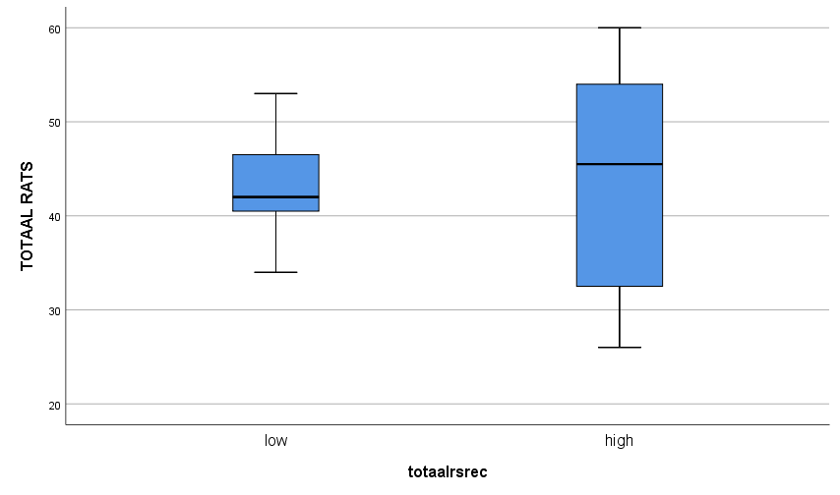
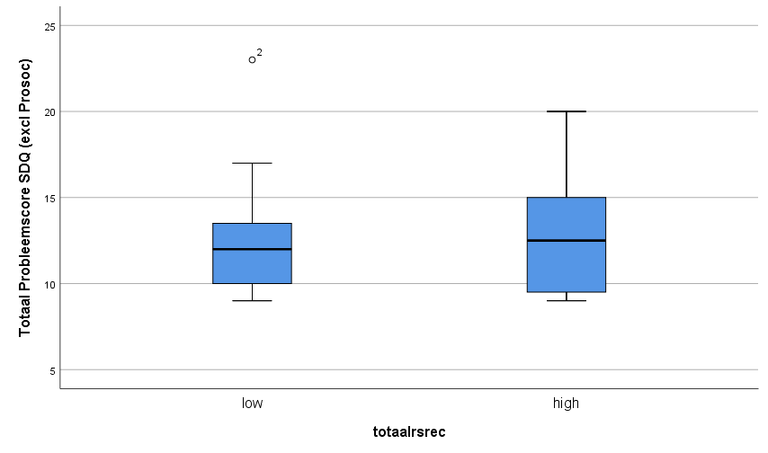
Results
What about resilience?
Trauma symptoms
Behavioral problems
No differences in behavioral problems or trauma symptoms in children with low (< pc 50) or high (>= pc 50) levels of resilience (t-tests and Mann-Whitney U tests, p < .05)
Correlation of resilience with behavioral problems and trauma symptoms is very small

Slide 20
Conclusion and discussion
Answers on research questions (1)
How do UMR develop in Flemish foster care? We found that
UMR have significantly more behavioral problems than the norm group
3 UMR had clinical scores and 1 had borderline scores
UMR have marginally significant more trauma symptoms than the norm group
1 UMR had clinical scores and 4 had borderline scores
UMR in foster care have significantly less resilience than the norm group
5 UMR had clinical scores and 2 had borderline scores
⇒ The development of UMR is problematic. When the cut-off of pc 60 is considered, 13 of 19 UMR have trauma symptoms

Slide 21
Conclusion and discussion
Answers on research questions (2)
Staying in a foster family from the same culture was not a protective factor. Children in a foster family from the same culture did
NOT have less behavioral problems
NOT have less trauma symptoms
NOT have more resilience
Resilience was NOT associated with positive development (behavioral problems or trauma symptoms).
Resilience as a personality characteristic was not moderating positive adaptation
Problems were not associated with duration of placement, suggesting that problems do not decrease over time
Foster families from the same culture had a LOWER educational quality compared to autochthonous foster families
Level of trauma symptoms and behavioral problems was not associated with educational quality

Slide 22
Conclusion and discussion
Answers on research questions (3)
Social contact with all cultures (own, other non-Belgian, and Belgian) and all sorts of persons (youngsters and adults) was positively associated with less trauma symptoms
Social contact protects against trauma or social contact heals trauma
Youngsters with many trauma symptoms avoid social contact
Social contact with autochthonous persons (Belgian) was positively associated with less behavioral problems. May be the result of a better integration
Social contact with autochthonous persons/integration protects against behavioral problems or social contact decreases the level of behavioral problems
Youngsters with many behavioral problems have much conflict with autochthonous persons, resulting in less social contact or worse integration

Slide 23
Limitations
The needed multiple consents resulted in a small sample which
Questions generalization
Reduced statistical power increasing the risk of type-II error (not rejecting the null-hypothesis while it should)
All questionnaires were in Dutch and some of the youngsters had limited understanding of Dutch (although a researcher was present to offer help if needed)
The presence of the researcher could have lead to social desirable answers

Slide 24
recommendations
UMR are at risk for trauma symptoms and behavioral problems. Screening and assessment is recommended
Trauma symptoms will probably do not decrease over time, so treatment may be needed
UMR are NOT preferably placed in a foster family of the same cultural background of the UMR, as these do not protect against trauma or behavioral problems and educational quality is worse
Social contact may help decrease trauma symptoms. Facilitating contacts with persons the UMR feels connected to is recommended
Integration and contacts with autochthonous persons may help decrease trauma and behavioral problems. Activities promoting integration such as school, leisure activities is recommended
Resilience is not granted, so interventions promoting resilience may be needed. Social contact and integration do also promote resilience.

Slide 25
Questions?

