Slide 1

Unaccompanied minors in the UK and research on their accommodation, education, and wellbeing in England and high-income countries
Dr Ellie Ott
Research Fellow
Rees Centre, Department of Education, University of Oxford
ellie.ott@education.ox.ac.uk | twitter: @eleanorott
rees.centre@education.ox.ac.uk | tel: +44 1865 274050 | twitter: @ReesCentre
Collaborators: Dr Aoife O’Higgins, Dr Michael Shea, Caitlin Prentice, Habib Rezaie
Unaccompanied minors: Policy and practice in European countries | 27 June 2019
Notes:
Keys to child protection: the accommodation and education of refugee children in high-income countries
Objectives: This paper combines the findings of three research projects focused on the important role of accommodation, care, and education of refugee children in high-income countries, as enshrined in the UN Convention on the Rights of the Child. First, we look at the impact of placement type on the educational and health outcomes of unaccompanied refugee minors (URMs). Then, with a lack of educational data on URMs, we look at outcomes associated with educational provision for all refugee children in high-incomes countries. Finally, we examine findings from a mapping exercise on educational provision for URMs in England to understand where there are gaps of statutory obligations, how this provision is tailored to recovering from trauma and loss, and where there are promising practices that should be further researched.
Methods: This presentation presents the findings from two high-quality systematic reviews on the impact of placement type for URMs and on the outcomes of the educational provision for refugee children in high-income countries. The mapping exercise on educational provision in England includes semi-structured interviews (n=14) with virtual school heads, teachers, social workers, and third sector providers, document analysis, a workshop at the Department of Education with key stakeholders (n= approx. 30) to be held in May, and analysis of administrative data where available.
Results and conclusions: An exploratory meta-analysis shows URMs placed in family foster care have better mental health than those placed in other forms of accommodation, but education, health, and protection outcomes and mechanisms for these outcomes need further research. Preliminary analyses indicate that some URMs in England receive education provision that does not meet needs or statutory obligations while others receive tailored and thoughtful provision. Findings also indicate consensus among practitioners that migrant children have particular educational needs tied with language acquisition, past trauma, and acculturation.

Slide 2
Introduction
“When the school found out what this child had been through, they got a little bit nervous and said that we’re getting lots of resources to deal with this and this sort of thing […] what the school didn’t realise is that he was desperate to go to school. This was the one thing in his mind that might ease some of that pain that he was experiencing.” –Virtual School Head, responsible for education of children in care
“There’s bad people and there’s good people, but as far
as I’ve seen, they treat you more as a thing, as a number,
rather than human being… and that goes for Home
Office and Social Services.” - Ilir in Chase et al, 2017
Notes:
2017 - Outstanding Individual Learning Award
Education & care as a source of continuity & disruption of ideas
Media context
Personal background
Professional interest

Slide 3
Outline
Context and background on the numbers
Policy and practice context in the UK
  Accommodation and matching to foster carers
  Education
  Mental health concerns
  Becoming adult and transition from care
Headlines from Rees Centre research looking at Unaccompanied Minors across high-income countries
  Systematic review on the impact of placement type for unaccompanied minors
  Systematic review on education provision for refugee children
Concluding thoughts

Slide 4
Context
A note on terminology
United Kingdom terminology - An Unaccompanied Asylum-Seeking Child (UASC) is a person under 18, or who, in the absence of documentary evidence establishing age, appears to be under that age, is applying for asylum on his or her own right and has no relative or guardian in the country of asylum
Separated children are those separated from both parents, or from their previous legal or customary primary care-giver, but not necessarily from other relatives (Child Protection Working Group, 2004: 13)
Refugee (1951 Convention and 1967 Protocol)
Based on commonality of experiences and needs often consider:
  Refugee, asylum-seeking, and forced migrant minors together
  Unaccompanied, separated, and accompanied minors together
Problematised issues of labels, age, and agency
Notes:
Refugee: 4,560 unaccompanied asylum-seeking children in care — 6% of 70,440 looked after children (from 2015-2016 a 54% increase) (DfE 2017)
Accommodation: 16+ generally semi-independent, and under 16 or vulnerable, generally in foster homes - “harder to place”
More likely to be placed out of local authority boundary & in independent fostering agencies
Afghanistan, Eritrea, & Albania major countries of origin

Slide 5
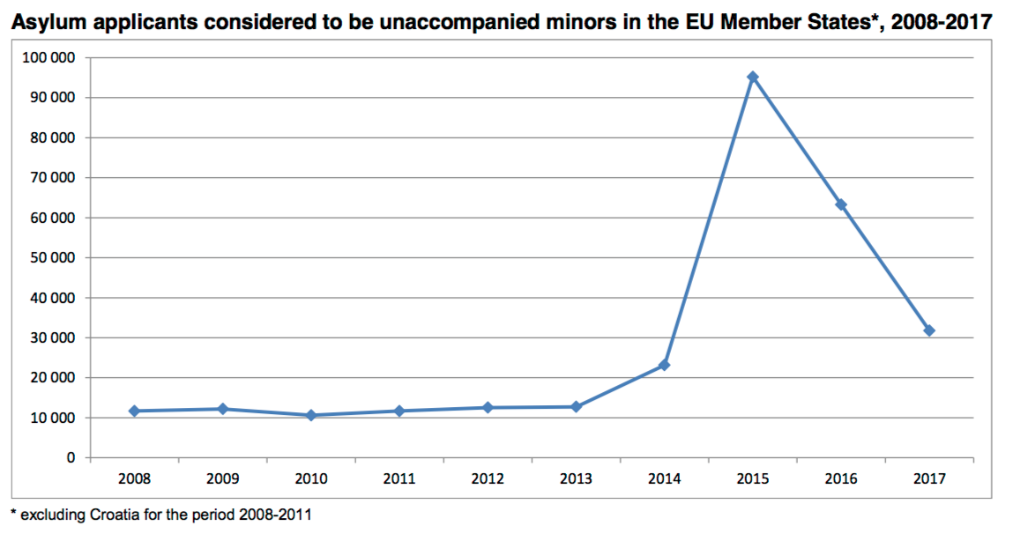
European context - Eurostat (2018)
Notes:
http://ec.europa.eu/eurostat/documents/2995521/7244677/3-02052016-AP-EN.pdf/19cfd8d1-330b-4080-8ff3-72ac7b7b67f6
Over half from Afghanistan, then Syria, Eritrea, Iraq, Somalia, Gambia;
Countries: Sweden (35,000), Germany (14k+), Hungary, Austraia (8k+), Norway (4k), Italy (4k), Netherlands (3.8k); UK (3k)
91% males, 13% below 14

Slide 6
United Kingdom context – data from Home Office (2019)

Slide 7
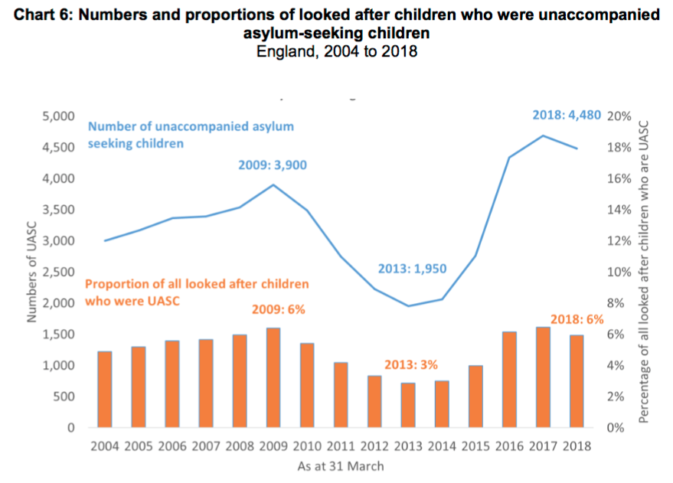
How many UASC are in care in England? (DfE, 2019)
4,480 (2018)

Slide 8
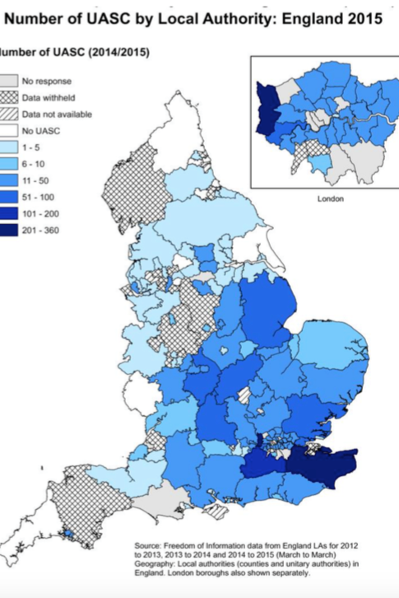
English context for UASC
Local authorities have responsibility for them
Generally around 90% are boys, 75% aged 16 or older
Accommodation: 16+ generally in semi-independent accommodation and under 16 or vulnerable generally in foster homes
More likely to be placed out of local authority boundary & in independent fostering agencies
Afghanistan, Eritrea, & Albania major countries of origin
Humphries & Sigona, 2016
Notes:
General care population: 74% in foster placements: 62% placed inside the council boundary, 16% fostered by a friend or relative

Slide 9
English policy and practice context
Implemented National Transfer Scheme (new guidance operational from March 2018, interim guidance in 2016)
  Any local authority authority with a UASC population above 0.07% of its child population can request transfer of UASC
Initial appointments:
  Health, dental, social services, Home Office (legal)

Slide 10
Messages from research on accommodation and matching to foster carers
Matching factors included: ethnicity, religion, language, extent they would speak and learn English, “family fit”, location of placement, and lifestyle & house rules (Wade, Sirriyeh, Kohli, & Simmonds 2012)
Risks in matching purely by race or ethnicity (e.g. some Afghan children had conflicts with Pakistani families) (Wade, Sirriyeh, Kohli, & Simmonds 2012)
  No significant association in ethnic matching and the extent to which young people felt integrated in the family
  Matched carers were more likely to go to religious & cultural events young people versus non-matched carers (religious: 87% vs. 56% white & 55% minority ethnic carers)
  No other differences in range of other share activities
  Broader literature that placements are less likely to disrupt when carers take part in joint activities with children (Sinclair 2005), importance here of being flexible and open about the type of activity
Notes:
Matching factors mentioned by social workers, foster carers, & young people included

Slide 11
Settling into foster care
Important to explain to young people what foster care is
Support for foster carers varied, recent training by The Refugee Council
To welcome, young people talked about importance of foster carers:
  Preparing them familiar food and allowing comfort in food (Kohli, Connolly, & Warman, 2010)
  Displaying a calm, relaxed, and non-intrusive manner (Kohli 2006)
  Introducing them to the household
  Allowing them to rest
Frequent conflicts and negotiations around house rules
Important to foster carers show they care and help create a consistent and predictable environment (Chase, 2013)

Slide 12
English policy and practice for education
Official policy of appropriate, full-time education within 20 days, but frequent delays in accessing education
Education can be mapped into bespoke, mainstream (secondary schools for under 16, colleges for aged 16+), and English language provision (Ott & O’Higgins, in press)
Creative ways of using the £2300 ‘pupil premium plus’ for this population including tutoring, material resources, & interim provision
Young people often have high educational aspirations
Issues around initial assessments, provision for those with low-levels of English, provision matching aspirations, supports for accessing and remaining in education
Notes:
Vulnerable study bursury of £1200 for those aged 16-19 and in FTE

Slide 13
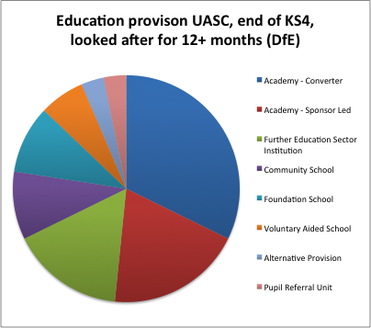
What does the data tell us about UASC education?
From the data:
50% of UASC who have been looked after for 12 months (March 2017) have a Unique Pupil Identifier (UPN) (Ott & O’Higgins)
Those completing exams do well. In regression analyses by O’Higgins (2018), earlier arrival in the UK / in care, placement in foster or kinship care, lower SDQ score, mainstream provision, and fewer school changes predicted better exam scores. Care and stability matter.

Slide 14
Mental health and wellbeing
Higher mental health concerns – including anxiety, depression, and PTSD, but also resilience (Bronstein, Montgomery, & Ott, 2012)
In Oxford, more than a quarter of refugee children & UASC in Oxford has significant psychological disturbance on the strength and difficulties questionnaire (Fazel & Stein, 2003)
Aligns with other research that UASC have relatively high rates of PTSD and depression (e.g. Bronstein & Montgomery, 2011)
May or may not confirm to vulnerability expectations (O’Higgins, 2012)

Slide 15
Becoming adult (Chase, Meloni, Sigona, et al)
Officially, dual care planning and personal advisors until 21 to 25
In practice, abrupt transitions and transition to independent housing at 18
UMs can make highly successful transitions with adequate care and support
UMs face specific difficulties compared to non-migrant young people in care
Some UMs disengage because fear detention & removal
  Survive based on social networks
  Transition often includes homelessness, destitution, poor mental & physical health

Slide 16
What is ‘care’ for unaccompanied minors?
Topic of a new £1 million research ESRC grant where I am a co-Investigator
Unaccompanied minors often care for each other, but these non-biological relationships are not necessarily accounted for in professionals decisions, such as accommodation (Crafter & Rosen, 2019)
Tensions between ‘best interests of the child’ and ‘hostile environment’ for immigrants

Slide 17
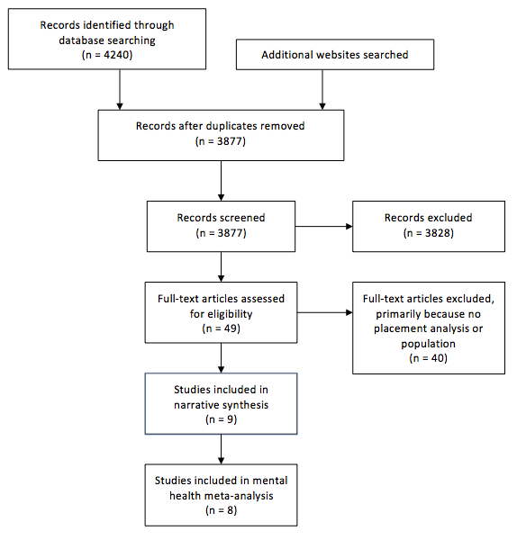
Findings: Impact of placement types
Dr Aoife O’Higgins, Dr Ellie Ott, & Dr Michael Shea
Methods:
  Systematic review
  Looking for physical health, mental health, or educational outcomes
Findings:
  Limited literature
  Exploratory meta-analysis: foster care correlates with improved mental health outcomes
  Theory that placement with co-ethnic individual correlates with improved outcomes

Slide 18
Included studies with mental health outcomes
Study | Location | N | Comparison groups (% of total sample) | Methodology | Findings
Porte and Torney-Purta (1987) | USA | 82 Indochinese | Foster care with white American family (35.3), foster care with Indochinese family (12), group home (23), living with own family (29). | Cross-sectional. Self-report questionnaires: CES-depression | Mean depression score for the total sample was 18.25 (more than 2 points above clinical cut off of 16 for depression). There were significant differences between groups by living arrangement; children in foster care (score 26) or group homes (score 24) with white Americans had higher scores than their peers living with same ethnicity foster families (score 12) or their own families (score 13). Regression analysis showed ethnicity of foster carers was significant in predicting depression scores.
Geltman et al. (2005) | USA | 304 Sudanese | Foster care with American family no Sudanese (16), foster care with American family and other Sudanese (36), group home with other Sudanese (20) and living with family or friends (18) | Cross-sectional. Interviews and self-report questionnaires: CHQ, HTQ & Ways of Coping | 20% of the sample scored on diagnostic range for PTSD Living in a group home or in foster care with an American family but no Sudanese youth, as opposed to living with a Sudanese family (kin or not), was associated with a higher risk of PTSD and lower CHQ scores; feeling lonely or isolated where they live, and less participation and satisfaction with group activities were also correlated to PTSD scores. Feeling safe at home and in school was associated with lower PTSD scores.
Bean et al. (2007) | Netherlands | 582 | Detention (29.7) was compared to foster care or living with family as one group (35.6) | Longitudinal Self-report, teacher & guardian questionnaires: HSCL-37A, SLE, RATS, CBCL, CBCL Teachers | Accommodation type significantly predicted HSCL internalising and RATS total scores over time, with those living in large reception centres reporting worse outcomes. (Effects sizes are not provided in the paper, attempts were made to contact the author but these were not successful).
Derluyn et al. (2007) | Belgium | 166 | Large-scale centres (adults and children (39), small centres (32), foster care (8), alone (17) or mainstream care arrangements (4) | Cross-sectional. Self-report & social worker questionnaires: HSCL-37A, SLE, RATS, CBCL, CBCL Teachers | Girls had higher scores on almost all subscales. Placement type was associated with HSCL-37A depression subscale scores, with the lowest scores for young people living alone and on the externalising subscale with young people living alone or in foster care scoring lowest.
Hollins et al. (2007) | UK | 99 Albanians | Foster care (8), children's homes (30), shared housing (38) or bed & breakfasts (B&B) (23) | Cross-sectional. Self-report questionnaire: GHQ, diary sheet & clinician interview | Those in B&Bs significantly more worried (78%) about housing, safety, housemates. Whereas 88% of those living with friends and foster family liked where they lived. 35% of older YP reported important psychological difficulties whereas only 1 (5%) of younger group (living in foster care or children’s homes). Living in unsupported housing was associated with ‘caseness’ on the GHQ.
Hodes et al. (2008) | UK | 78 | Foster care (41), children's homes (93.8), semi-independent (21.8) or independent (33.3) | Cross-sectional. Self-report questionnaires & assessments. Case file reviews | Contrasts showed that with foster care as baseline, living with one parent or other family member was associated with signiﬁcantly lower scores and living independently was associated with signiﬁcantly higher scores for PTSD symptoms, indicating worse outcomes for young people living independently. Placement type was a significant predictor on the Impact of Events Scale and for depression.
Seglem et al (2011) | Norway | 414 | Foster or kinship care (21.3), group home (30.3) , with partner (9.6) or alone (37) | Cross-sectional. Self-report questionnaires: CES-depression | ANOVA was also conducted to examine differences in depressive symptoms between living arrangements. When including all groups in the analysis these differences were not significant. An independent t-test was then carried out and found a small significant difference between the scores of young people living with a family compared to all other living arrangements together.
Bronstein et al. (2012) | UK | 222 Afghans (male only) | Foster care (62.6), semi-independent and emergency accommodation (37.4) | Cross-sectional. Self-report questionnaires: SLE & RATS | Cumulative trauma and living arrangement were identified as having a significant relationship with PTSD, with those living in foster care experiencing lower levels of PTSD symptoms. Young people in foster care also reported fewer sleep problems.
HSCL – 37A: Hopkins Symptoms Checklist – 37Adolescents (for use with refugee children) ; SLE: Stressful Life Events; RATS: Reactions of Adolescents to Stress; CBCL: Child Behaviour Checklist; CES-depression: Centre for Epidemiological Studies Depression scale; CHQ: Child Health Questionnaire; HTQ: Harvard Trauma Questionnaire; GHQ: General Health Questionnaire; BDSR: Birleson Depression Self-Rating Scale

Slide 19
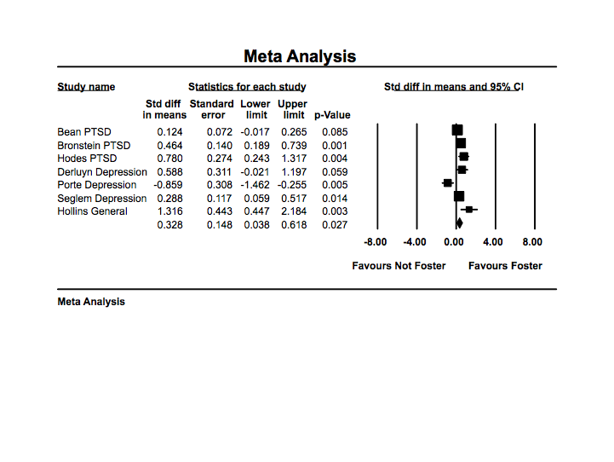
Exploratory meta-analysis

Slide 20
Included studies with educational outcomes
  Beyond this - a perception that family foster care impacts on safety and education (Brownless & Fitch, 2010; Hodes et al, 2008; Wade, Sirriyeh, Kohli, & Simmonds, 2012)
Study | Location | N | Comparison groups (% of total sample) | Methodology | Findings
Porte and Torney-Purta (1987) | USA | 82 Indochinese | Foster care with white American family (35.3), foster care with Indochinese family (12), group home (23), living with own family (29) | Cross-sectional. Self-report questionnaires reporting GPA | Children in ethnic homes (foster care with Indochinese family and own family) had adjusted mean GPAs that were .23 to .41 points higher than children in non-ethnic homes (t=2.45, p<.017). Children in ethnically matched settings were more likely to view success in school as a result of their own efforts. The study hypothesises this result as specific to Asian adult models who stress both the importance of education and effort as the pathway towards educational success.
Kalverboer et al. (2016) | Netherlands | 132 | Foster family (33), Small living unit (23), Small living group (19), Campus (26) | Interviews used to complete the BIC-Q on quality of living environment | Minors in family foster care were significantly more likely to attend an ordinary Dutch school than those in living units, living groups, or campuses. Family foster care had a significantly higher percentage of minors for which the quality of education is judged 'satisfactory' or good' compared to campus (93% vs 64.7%).

Slide 21
Findings: Associations between educational provision and outcomes for refugee children
Methods:
  Systematic review including qualitative and quantitative literature
  Looking at ‘educational provision’ broadly defined and any type of outcomes (e.g. mental health, educational, employment)
Included studies:
  9 quantitative, 11 qualitative
  Countries:
    Australia (5)
    Canada (5)
    Italy (1)
    Spain (1)
    Sweden (1)
    UK (1)
    USA (6)
  2 PhD dissertations, 2 reports, and 16 journal articles

Slide 22
Findings
  Literature focuses on needs, barriers, but rarely evaluates programs or links provisions to outcomes.
  Included studies cover a broad range of provision (e.g. arts, sports, vocational + language, interim educational programs for refugee children to mainstream). Some young people disengaged if programming did not match aspirations or needs.
  Various methods are possible with this population, from cluster randomised controlled trials to in-depth qualitative research.
  Overall study quality is fairly low. Studies shows little evidence on effectiveness of interventions, but this does not mean evidence of ineffectiveness. Methodological issues include appropriate measurement, access, intensity of intervention, and sample size.
  Studies are useful for theory-generating.

Slide 23
Promulgation of two theories
Firstly, from a utilitarian perspective on education, initial assessments ensured placement in appropriate educational provision and lead to better long-term outcomes for wellbeing, educational progress, and employment.
Secondly, other studies hypothesised that the importance the ethos of the educational provision and having a supportive, welcoming environments in order to achieve improved outcomes.
Theories were distinct but not exclusive.

Slide 24
Concluding thoughts
Common theme of specific accommodation, educational, and mental health needs for UASC
  Acknowledgement that some needs that can be approached with common set of policies and practice and that for some needs, it is a heterogeneous population where services needed to be tailored.
Some indications of better outcomes with more of a family life and with continuity.
Strong belief in the importance of relationships – with foster carers, social workers, that a welcoming educational and holistic environment led to ‘getting to know’ young people better informally and to better outcomes.

Slide 25
Works cited
Bean, T. M., Eurelings-Bontekoe, E., & Spinhoven, P. (2007). Course and predictors of mental health of unaccompanied refugee minors in the Netherlands: one year follow-up. Social Science & Medicine (1982), 64(6), 1204–15. http://doi.org/10.1016/j.socscimed.2006.11.010
Bloch, M. C., Chimienti, M., Counilh, A. -L., Hirsch, S., Tattolo, G., Ossipow, L., & de Wenden, C. W. (2015). The children of refugees in Europe: Aspirations, social and economic lives, identity and transnational linkages. Final report - working paper. Geneva: SNIS.
Bourgonje, P. (2010). Education for refugee and asylum seeking children in OECD countries. Education International, 50, 1-12.
Bronstein, I., & Montgomery, P. (2011). Psychological distress in refugee children: A systematic review. Clinical Child and Family Psychology Review, 14(1), 44-56.
Bronstein, I., Montgomery, P., & Ott, E. (2012). Emotional and behavioural problems amongst Afghan unaccompanied asylum-seeking children: Results from a large-scale cross-sectional study. European Child & Adolescent Psychiatry, 22(5), 285-294.
Brownlees, L., & Finch, N. (2010). Levelling the playing field: A UNICEF UK report into provision of services to unaccompanied or separated migrant children in three local authority areas in England. Retrieved from http://www.unicef.org.uk/Documents/Publications/levelling-playing-field.pdf
Chase, E. (2013). Security and subjective wellbeing: the experiences of unaccompanied young people seeking asylum in the UK. Sociology of Health & Illness, 35(6), 858–872. http://doi.org/10.1111/j.1467-9566.2012.01541.x
Chase, Meloni, Sigona, Humphries, Allsopp, et al. (2016-2017). Various publications and policy briefs. https://becomingadult.net
Crul, M., Keskiner, E., Schneider, J., Leslie, F., & Ghaeminia. (2017). No lost generation? Education for refugee children: A comparison between Sweden, Germany, The Netherlands, and Turkey. In The integration of migrants and refugees: An EUI forum on migration, citizenship and demography. European Union Institute.
Department for Education (DfE). (2019). Children looked after in England year ending 31 March 2018.
Derluyn, I., & Broekaert, E. (2007). Different perspectives on emotional and behavioural problems in unaccompanied refugee children and adolescents. Ethnicity & Health, 12(2), 141–62. http://doi.org/10.1080/13557850601002296
Geltman, P. L., Grant-knight, W., Mehta, S. D., Lloyd-travaglini, C., Lustig, S., Landgraf, J. M., & Wise, P. H. (2005). The “Lost Boys of Sudan”: Functional and behavioral health of unaccompanied refugee minors resettled in the United States. Archives of Pediatrics and Adolescent Medicine, 159(June 2005), 585–591. http://doi.org/http://dx.doi.org/10.1001/archpedi.159.6.585
Hodes, M., Jagdev, D., Chandra, N., & Cunniff, A. (2008). Risk and resilience for psychological distress amongst unaccompanied asylum seeking adolescents. Journal of Child Psychology and Psychiatry, and Allied Disciplines, 49(7), 723–32. http://doi.org/10.1111/j.1469-7610.2008.01912.x
Hollins, K., Heydari, H., Grayson, K., & Leavey, G. (2007). The mental health and social circumstances of Kosovan Albanian and Albanian unaccompanied refugee adolescents living in London. Diversity in Health and Social Care, 4(4), 277–285(9).
Kalverboer, M., Zijlstra, E., Os, C., Zevulun, D., Brummelaar, M., & Beltman, D. (2016). Unaccompanied minors in the Netherlands and the care facility in which they flourish best. Child & Family Social Work, 22, 587-596.
McBrien, J. L. (2005). Educational needs and barriers for refugee students in the United States: A review of the literature. Review of Educational Research, 75(3), 329-364.
O’Higgins, A. (2012). Vulnerability and agency: Beyond an irreconcilable dichotomy for social service providers working with young refugees in the UK. New Directions for Child and Adolescent Development, 2012(136), 79–91. http://doi.org/10.1002/cad.2001
O’Higgins, A. (2019). Analysis of care and education pathways of refugee and asylum-seeking children in care in England: Implications for social work. International Journal of Social Welfare, 28(1), 53-62. http://doi.org/10.1111/ijsw.12324
O’Higgins, A., Ott, E. M., & Shea, M. W. (2018). What is the Impact of Placement Type on Educational and Health Outcomes of Unaccompanied Refugee Minors? A Systematic Review of the Evidence. Clinical Child and Family Psychology Review. http://doi.org/10.1007/s10567-018-0256-7
Porte, Z., & Torney-Purta, J. (1987). Depression and academic achievement among Indochinese refugee unaccompanied minors in ethnic and nonethnic placements. The American Journal of Orthopsychiatry, 57(4), 536–547.
Seglem, K. B., Oppedal, B., & Raeder, S. (2011). Predictors of depressive symptoms among resettled unaccompanied refugee minors. Scandinavian Journal of Psychology, 52(5), 457–64. http://doi.org/10.1111/j.1467-9450.2011.00883.x
Wade, J., Sirriyeh, A., Kohli, R., & Simmonds, J. (2012). Fostering unaccompanied asylum-seeking young people. London: BAAF.

Slide 26
Thank you and questions?
Dr Ellie Ott
Research Fellow, Rees Centre
University of Oxford
ellie.ott@education.ox.ac.uk | twitter: @eleanorott
rees.centre@education.ox.ac.uk | tel: +44 1865 274050 | twitter: @ReesCentre
Unaccompanied minors: Policy and practice in European countries | 27 June 2019

Slide 27
Extra slides

Slide 28
English laws for duty of care
Responsibility by local authorities
Children Act 1989 (as amended by the Children and Young Persons Act 2008)
After 18, Care Leavers (England) Regulations 2010 – amended in 2014 to account for circumstances & needs of unaccompanied or trafficked children
Immigration Act 2016 – changed nature of support for UASC who are appeal rights exhausted (ARE)

Slide 29
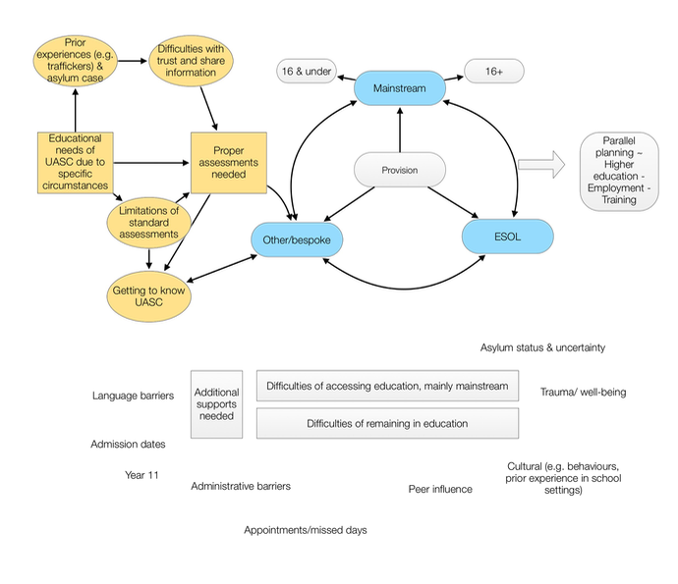
Mapping common themes

Slide 30
Study | Educational provision | Country | Sample size | Methods | Outcomes | Findings
Aytar & Brunberg (2016) | A Resilience Support Centre, offering homework assistance | Sweden | 15 unaccompanied minors | Interviews, some basic data tracking | School enrolment | Half needed homework help. Enrolment in education decreased over time (from 17/17 to 10/15), but may be related to age
Baker & Jones (2017) | Classroom music therapy services | Australia | 31 newly-arrived refugee students (15 in intervention, 16 in comparison) | Cross-over randomisation design, questionnaires MANCOVA | Behavioural problems | Findings suggest that music therapy reduces externalising behaviours but is non-significant for internalising behaviours (depression, anxiety) & behavioural status index
Chasin et al (1984) | Transition program | USA | 831 refugee children, but different n on each test | Pre/post (t-tests), no controls | Reading and maths (measure developed by New York City administrators) | Children progressed in both reading and maths
Gunasekera (2014) | Transition from a 2-year Intensive English Centre (IEC) to mainstream high school | Australia | 60 African pupils | Pre- / post- tests with t-tests, Interviews | Delinquency, Educational goal setting, aggression and health related behaviours | Statistically significant increase in number of academic goals set (t=-14.45), increase in delinquency activities and aggression, no change in drug use, and decrease in school connectedness and teacher connectedness. Qualitative interviews suggest this is due to transition rather than IEC that was viewed positively.
Rousseau et al (2014) | Classroom-based drama workshop | Canada | 477 immigrant and refugee youth (incl. Canadian-born): 157 in drama, 180 in tutoring, and 140 in treatment as usual | cRCT | SDQ Behaviour problems, Impairment and school performance | Self-reported impairment and symptoms = ns, vs tutoring vs nothing. Impairment scores decreased for first gen teens, while it increased for 2nd gen teens. No sign findings on maths or French GPA in drama or tutoring groups.
Rousseau et al (2007) | Classroom-based drama therapy | Canada | 123 adolescents, targeted for immigrant and refugee adolescents | Pilot RCT | Behaviour, Self esteem & school performance (report cards, GPA- Maths & French) | Non-significant findings on emotional behaviours. Improvement in maths GPA for treatment group (mainly due to boys), non-significant for French. Less impact except on learning in T group; in C group, more impact on distress and friendships and higher impact score overall. NS differences in teacher reports
Rousseau et al (2012) | School-based intervention integrating drama and language awareness | Canada | 55 students (27 treatment, 28 control), targeted towards refugee and asylum-seeking children | Pilot pre / post, T v C | SDQ and impairment (not clear what this refers to (not in methods) | SDQ no change, impairment decreased in treatment group but not in control group. Children exposed to pre-migratory violence may have benefited more.
Sekhon (2003) | Acculturation and school adaptation of Somali Bantu refugee children | USA | 175 Somali Bantu refugee students in 5 elementary schools (21 School A, 25 School B, 44 School C, 37 School D, & 48 School E) | Mixed-methods Survey, administrative data, MANOVA, regression | School grades, SDQ, Acculturation indexes (including language and behavioural) | Schools contribute more variance to acculturation and language acculturation indices than other variables. Students from School D scored significantly higher on the SDQ difficulties and lower grades on School Behaviour compared to students from other schools
Swyer & McCloskey (2013) | One-month intensive literacy and football camp | USA | 35 young people | Pre/post (t-tests) & observations | Reading, writing, | NS findings on Bader Reading Inventory (t=1.02), Decoding results non-significant (t=2.09), overall writing non-significant (t=.36). No regressions.
Wilkinson (2001) | The Integration of Refugee Youth in Canada | Canada | 97 refugee youth (91 for a structured survey, & 11 interview) | Structured interview survey, follow-up interviews | Educational status (“on track”, high school only, drop out) | Grade placement on arrival predicted educational status after controlling for other covariates.
Li & Grineva (2016) | ESL & Literacy Enrichment and Academic Readiness for Newcomers (LEARN) program in a High School (incl. simplified mainstream curriculum & after school homework club) | Canada (Newfoundland) | 15 refugee pupils (15 questionnaires, 6 pupil interviews & teacher interviews) | government documents, qualitative questionnaire, semi-structured interviews, observations | Academic and social challenges reported | Despite program of ESL and LEARN, limited total impact. Low levels of English hold kids back.
Flansburg & Kalmar, Catholic Charities of Richmond (1992) | 2-year bilingual vocational education in a mainstream high school | USA (Virginia) | 97 pupils - mostly southeast Asian refugees, some from El Salvador | Interviews, school drop out rates, employment data | Improved high school drop out rates | Drop out rate for refugee pupils in the district dropped from 35% to 5%. Of previous year's program graduates, only one was not in employment or further education. Theorised importance of bilingual education and applied education to help pupils stay engaged.
Bond et al (2007) | Changing cultures project: education and training; includes a language program | Australia | Between 183 and 260 pupils each year, 1160 total – targeted for refugee young people | English test scores, survey of pupils' future plans, records and audit forms of meetings, discussions of program staff, interviews with site managers | English levels | Tests show that language levels (ISLPR scores) are improving (does not measure at an individual level), but generally still not high enough to access further education. Theorised to help due to more holistic provision.
Auger-Voyer, Montero-Sieburth, Cabrera Perez (2014) | Educational provision for UASC living in a reception centre: mainly attendance at mainstream school for u16 & vocational program for 16+ | Spain (Canaries) | 10 UASC age 15-17, 6 former UASC age 18-22, 8 reception centre staff, and 5 local practitioners | participant observation, semi-structured interviews | Attendance at educational provision | Attendance at school and tutoring was poor and young people were generally unengaged. Attendance at internships better and attitudes more positive. Most participants did not have much prior schooling, author thinks this caused lack of engagement with educational provision on arrival. Peers were often SEN or also had poor attendance in vocational programmes. Of the six previous UASC, two were employed, one was waiting for a schoalrhsip to continue studies, and three were uemployed and “living in precarious situations”
Crawford | Music education | Australia | 10 refugee background students age 13-17, 3 teachers or principals | Semi-structured interviews, observations. Interpretative phenomenological analysis | "experiences and perceptions of school, the music class, aspects of learning and aspirations for learning" (p. 347) | Authors theorised that music education worked by creating a safe environment and enjoyment to enhance learning.
Madziva, Thondhlana (2017) | Mainstream education provision for Syrian refugee children | UK (Nottingham) | 15 Syrian refugee children and young people aged 7-21, 16 adults aged 30-55, and professionals | Interviews with translator, focus groups (originally wanted to do with all participants but people didn't like speaking in front of others) | General how are kids getting on at school, with a language focus | Good progress of English language. Theorised mechanisms for better educational outcomes included placing children in provision according to their needs (e.g. deaf children placed correctly), welcoming enviornments, engagement with parents, teacher training to meet needs, report on children’s achievement, including children in mainstream activities, and support to children to develop linguistic capabilities. Authors noted the importance of English language – either total immersion or bilingual education.
Belazelkoska (2007) | Urban high school provision | US (Midwestern urban) | 10 recently graduated pupils of Serbian | Individual interviews of 90 min. to 2 hours, allowing participant to lead the conversation | Factors contributing to high school graduation | All 10 participants graduated high school and attended or were accepted to attend a four year college or university
Weekes et al (2011) | “The Classroom Connect Project”: Tutoring in once a week mainstream secondary schools | Australia | 23 refugee students, 27 tutors, 12 school principles | Interviews | Students' academic progress and well being | Homework less stressful. Students can access curriculum better with organisation and language support. Some students feel stigmatised or singled-out.
Rania, Migliorini, Sclavo, Cardinali, Lotti (2014) | Tailored educational interventions offered through community centres | Italy | 10 unaccompanied migrant adolescents | Semi-structured interviews | Success of educational intervention offered through community centres | Young people largely want education provision to support their employment. The incompatibility between provision and goals led to disengagement.
Wright (2004) | English-only education and bilingual assistance | US (California) | 10 Cambodian former pupils | In-depth interviews | Long term employment, education outcomes | All graduated high school and attended at least some college. Theorised that English-only provision led to weaker first language without full mastery of English, boredom because of lack of understanding of provision, and poor educational outcomes. Ability to maintain employment largely determined by English levels.

Slide 31
Findings: Care and educational pathways
by Aoife O’Higgins
UASC in care at 16 (n=167)
Findings:
  Bivariate correlations: Recording of Special Education Needs (SEN) (lower prevalence) did not significantly correlate with educational scores unlike care population
Table 1: Type of school
 | UASC |  | Children in care
 | N | KS4 points | N | KS4 points
Mainstream | 146 | 254.21(122.14) | 2825 | 277.04 (100.88)
Special schools | None | - | 1061 | 82.77 (82.78)
Pupil referral unit (PRU) | 7 | 57.68 (66.62) | 317 | 85.71 (80.64)
Alternative provision | 2 | 0 | 270 | 31.24 (56.50)
Further education (FE) college | 12 | 111.50 (64.36) | 131 | 143.34 (73.63)
Independent schools | None | - | 42 | 159.76 (145.53)
Other | None | - | 10 | 228.35 (143.08)

Slide 32
  Regression model predicted 48% of variance; children who entered care later, were not in foster or kinship care, had high SDQ scores, were not in mainstream school, or changed school in last two years prior to KS4 exams more likely to have lower attainment
  Lack of a unique pupil identifier (UPN) - identification, tracking, and educational opportunities?
Table 2: Regression output Outcome variable: KS4 points: 8 best exams +equivalents, max = 464
 | Standardized Coefficients (ß)
Age at first entry | -.219*
Not foster or kinship care at KS4 | -.148*
Number of placements | -0.076
SDQ Score (2013) | -.179*
School type at KS4 | .302**
Changed school | -.295**
Unauthorised absences | -0.069
Authorised absences | -0.084
R² = .48
Notes:
Triggered when they start in a mainstream school

Slide 33
Literature highlights
Beyond the legal framework or media portrayals, why focus on refugee children?
Specific histories that affect their learning, such as commonly interrupted school, trauma, isolation through different language and culture, missed traditional developmental stages, broken family and peer relationships, and strong co-ethnic peer relationships from travel or reception into a country
Refugee children have more educational barriers than immigrant children and the distinction is thought important in explaining pedagogical gaps and differences in outcomes (Bloch et al., 2015; Bourgonje, 2010; Crul, et al., 2017; McBrien 2005)
Higher levels of post-traumatic stress disorder and major depressive disorder (e.g. Bronstein and Montgomery, 2011)
Documented resilience
But… little is known…

Slide 34
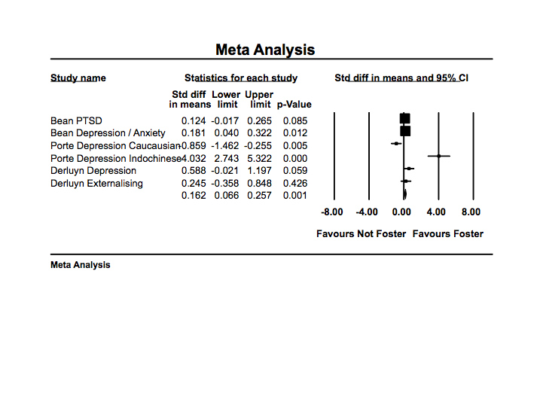
Exploratory meta-analysis 2: forest plot of studies with more than one measure

Slide 35
Why focus on education?
Schools play a key role in “children’s development, from peer relationships and social interactions to academic attainment and cognitive progress, emotional control and behavioural expectations, and physical and moral development ... [which] are reciprocally affected by mental health” (Fazel, Hoagwood, Stephan, & Ford, 2014: 377)

