Slide 1
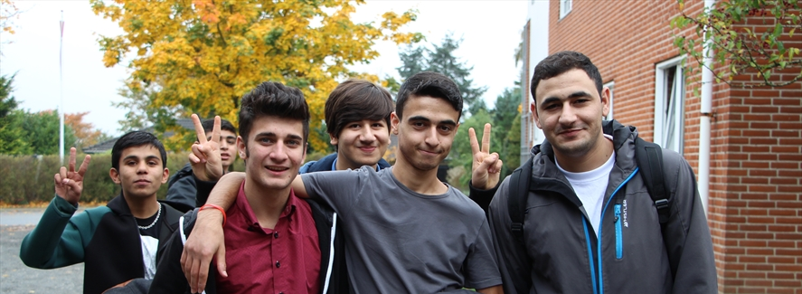
Mette Lausten VIVE – the Danish Center for Social Science Research
Unaccompanied minors in Denmark
– policies and practices
Lille, 27th of June, 2019

Slide 2
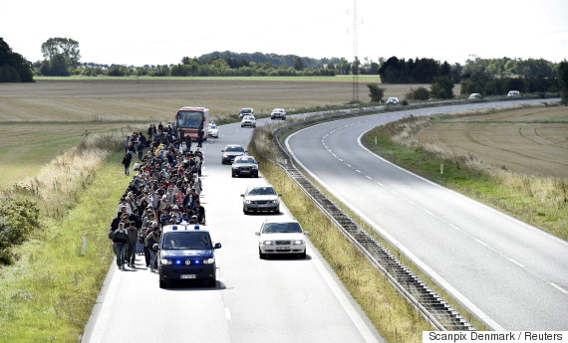
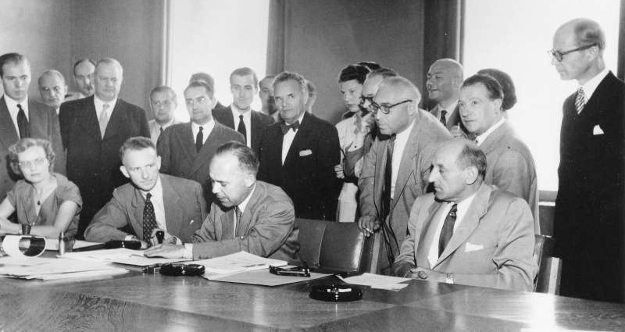
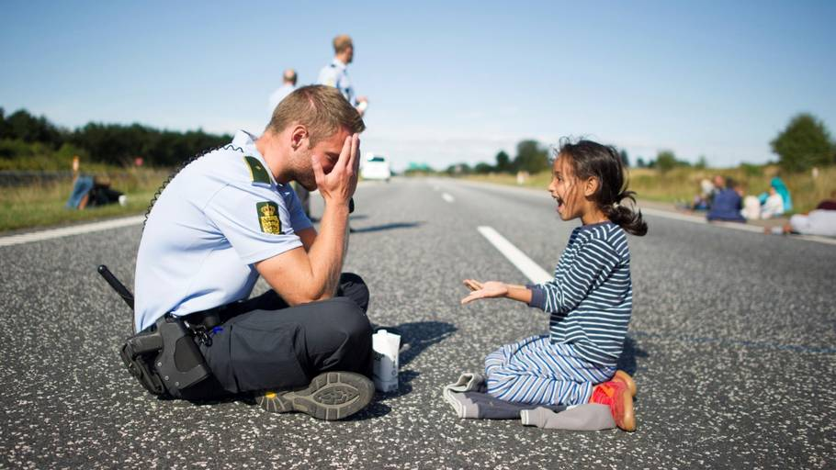
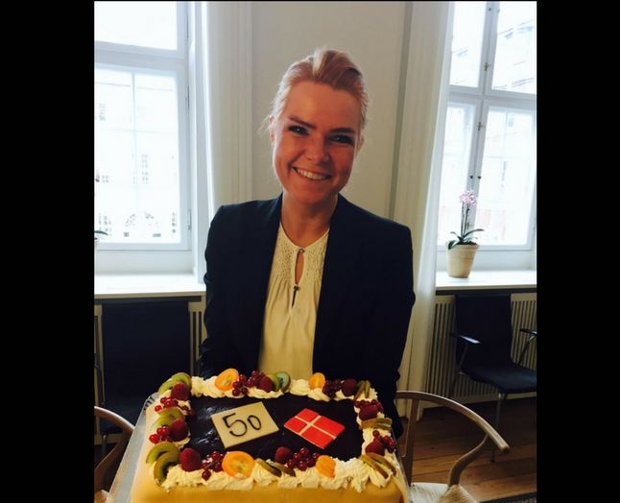
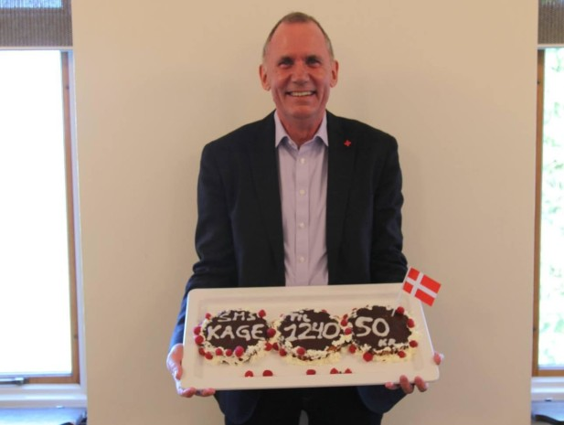
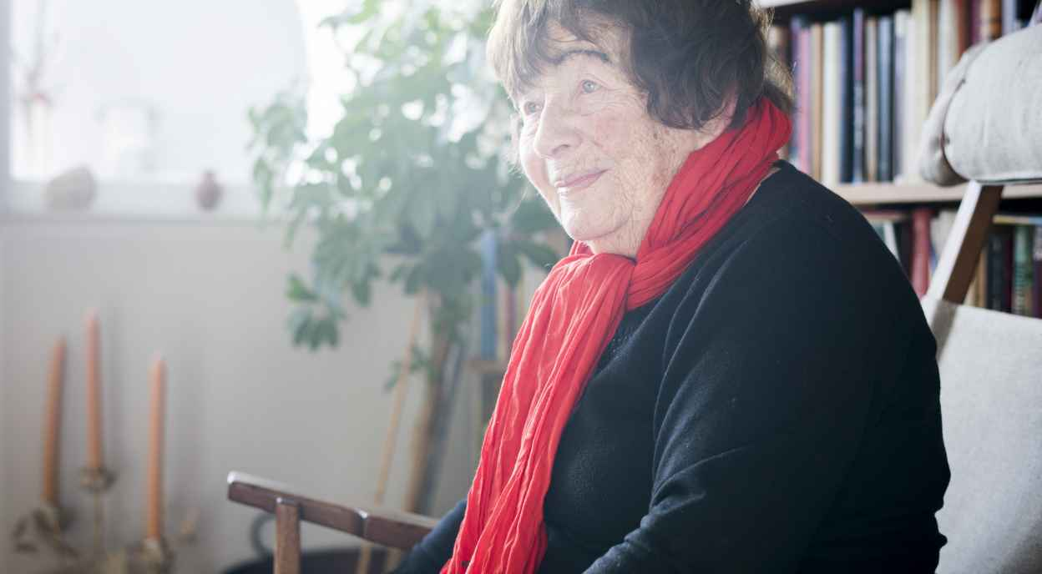
From the 1951 UN Refugee Convention to the Danish Aliens Act in 2019
Berlin, 1939
2017
2015
Anders Ladekarl, General Secretary at Danish Red Cross
Copenhagen, 2016

Slide 3
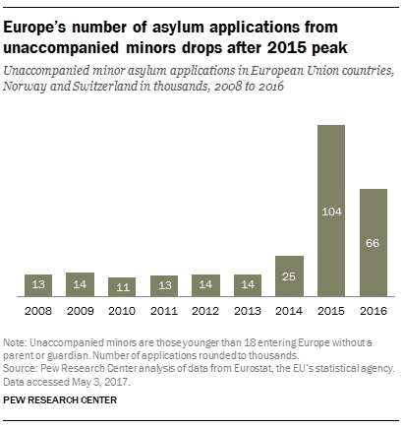
Unaccompanied minors in Europe, 2008-2016
Unaccompanied minor asylum seekers in EU, Norway & Switzerland in 1,000s, 2008-2016
104,000
Source: PEW Research Center analysis of data from Eurostat, the EU’s statistical agency

Slide 4
Unaccompanied minor asylum seekers in Denmark, 1999-2018
2,144
81
OBS: 2019 is for January-May
Source: The Danish Immigration Service

Slide 5
Unaccompanied minors per month, 2013 – May 2019
Source: The Danish Immigration Service

Slide 6
Countries of origin for the majority, 2006-2019
Source: The Danish Immigration Service

Slide 7
The process when coming to Denmark
Registration at the police and transport to the specific reception center for unaccompanied minors (all other asylum seekers goes to another center)
Asylum interview with the Danish Immigration Service with a member of the Red Cross as assessor
Temporary stay at an asylum child center, going to a red cross school, while asylum case is being processed (3 child centers in DK)
When (temporary) residence permission is given, the young person is refers to a specific municipality
The municipality decides how the young person should reside, i.e. own dwelling, residential care (sociopedagocical homes), foster care
Temporary custodian is appointed
Ordinary daily life, schooling, leisure activities, spare-time job, friends
Depending on the length of residence permission, application for extension has to be made

Slide 8
Unaccompanied minors in between two laws
The Danish Aliens Act
–
Being an asylum seeker
The Danish
law on
social Services
–
Being a child in need
Refugee or
child?

Slide 9
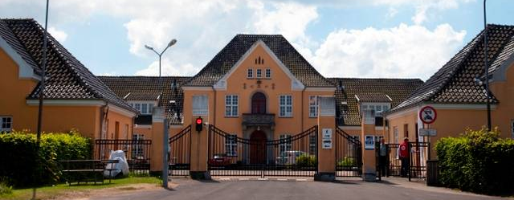
Examples from research
Differentiated municipal approach
Type of residence means all
One of the centers in DK

Slide 10
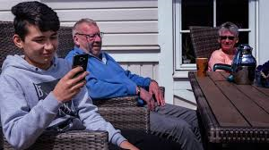
One municipality test a new concept
Young persons are based at residential homes:
Use of integration families
Use of friendship families
The role of the custodian
Within municipal intersectional cooperation

Slide 11
Evaluation of the results:
Welfare state thinking, that “Everybody needs a family” does not always work
Need reconciliation of expectations at both municipal and youth level
Friendship families with no formal obligations work the best
The division of roles between municipality and custodian has to be clear to make progress
Established and agreed upon partnership supports the intersectional cooperation, incl. local volunteers

Slide 12
Research at residential homes level (I)
Living with ‘local’ young persons in out-of-home care
Not correct match
Different kinds of vulnerabilities
Not easily adaptive to institutionalized settings
Miss contact with ordinary young Danish persons
Not guaranteed after care when ‘aging out of care’

Slide 13
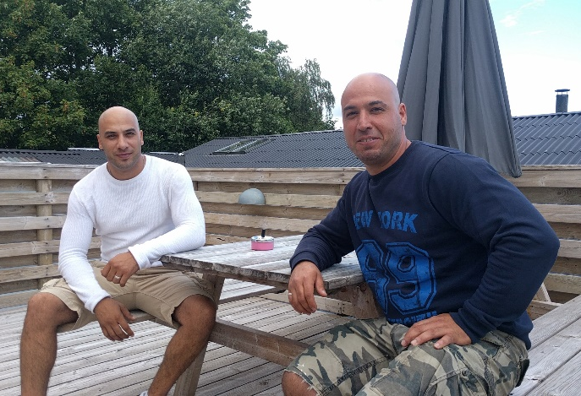
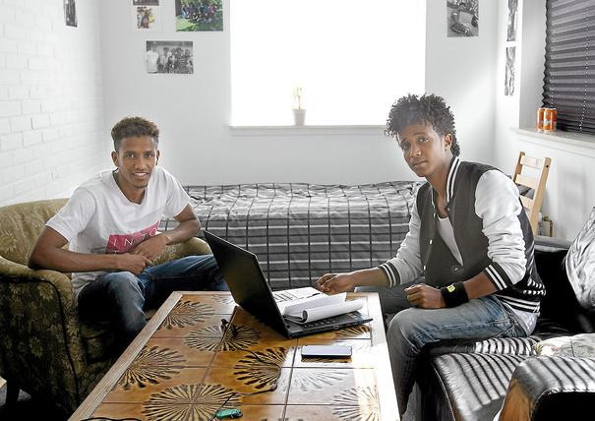
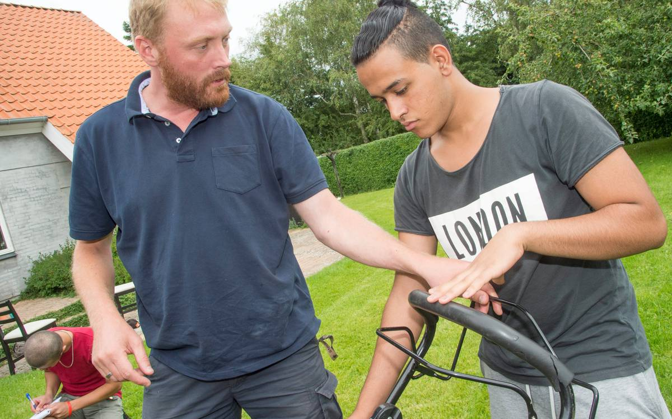
Research at residential homes level (II)
At the same time:
Happy to live with other unaccompanied minors
Employing former unaccompanied as role models
Some level of expertise at the home, specializing in giving the correct support to later independency

Slide 14
Some are placed in their own dwelling (living alone)
Often treated as adults and not as children in need
High degree of loneliness
No custodian
Only visiting person is a contact person twice a week
Not support to build new social relations
When unaccompanied minors are spread out all over DK, there is no municipal expertise, no specialized interventions

Slide 15
In loco parentis?
Does it work?
The ‘fight’ between the Aliens act and the welfare state
Children in need >< street-oriented children

Slide 16
Specific need for relations:
bonding (getting by…)
bridging (getting on…)
Need for education – to manage adult life
Thank you for listening

