Slide 1


A review of needs and profiles of unaccompanied immigrant minors as well as services and practices in Spain
Jorge F. del Valle, Amaia Bravo, Iriana Santos
GIFI Research Group University of Oviedo

Slide 2
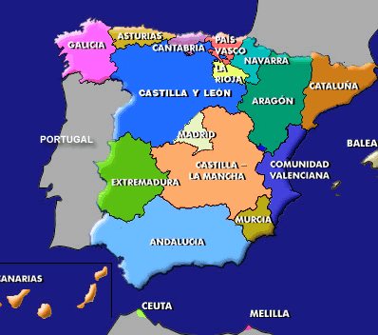
Decentralized government
17 Autonomous communities
Government, Parliament and Autonomic Laws
Responsibility for child protection and services

Slide 3
Current Child Welfare Legal Framework
1987 Law on Foster Care and Adoption (reforming the Civil Code)
  Introducing family foster care in Spain
  Facilitating adoption
  Family preservation as a main priority
  Autonomous governments as regional authority for child care (regional laws…)
  No need for court intervention in case of clear cases of abuse or neglect, regional government can make a child protection order and take guardianship immediately

Slide 4
Child Welfare Current Legal Framework
1996 Constitutional Law on Child Protection
  Developing main ideas of 1987
  Introducing the Convention on the Rights of the Child
  Introducing the need for intervention also in cases at risk
Reform of Constitutional Law in 2015
  Prohibition of residential placements for children under 6 years old
  Obligation to develop services for young people leaving care (before and after)
  Detailed regulation of the use of therapeutic residential care (specialized residential care) in terms of process, court supervision, etc. (not in terms of models of intervention….)
  Regulation of immigrant unaccompanied minors

Slide 5
Residential care evolution:
From institutions to family model (late XXth Century)
  Children’s homes, small family units
    4-7 children//6-8 social educators
  Based on normalization theory
    Community integration
    Family environment and routines
  Professionalization
    Social educators: university degree (4 years)
  Not allowed for children under 6 years old
  Specialization
    Therapeutic residential care
    Transition to adulthood
    Unaccompanied immigrant young people

Slide 6
Referrals per year to residential versus family foster care
(5,717 UIM)
Boletín Estadístico de Medidas de Protección. Ministerio de Sanidad, Servicios Sociales e Igualdad
Notes:
En este gráfico se puede apreciar que en el número de casos nuevos al año la tendencia es clara: el acogimiento familiar tiene una tónica muy similar en sus cifras de los últimos 15 años mientras que el acogimiento residencial experimenta en los últimos años importantes aumentos pero que tienen que ver con la llegada de menores extranjeros no acompañados. Un fenómeno que se frenó y descendió durante la crisis económica como se ve en el gráfico de 2008 a 2012 y está repuntando en estos últimos años de forma muy alarmante.

Slide 7
Situation 31st December
Boletín Estadístico de Medidas de Protección. Ministerio de Sanidad, Servicios Sociales e Igualdad
Notes:
En términos de cuantos menores están a final de año (no las altas como el anterior) si que existen más acogimientos familiares que residenciales y en ambos se aprecia un nivel muy similar de casos a lo largo de los años

Slide 8
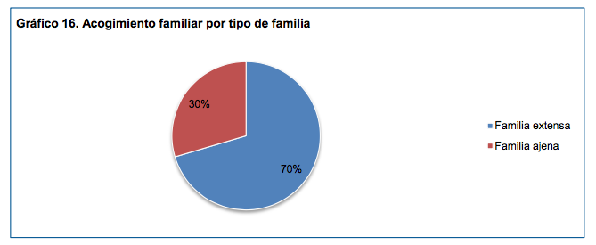

Slide 9
Out-of-home care in Spain. 31st December 2017

Slide 10

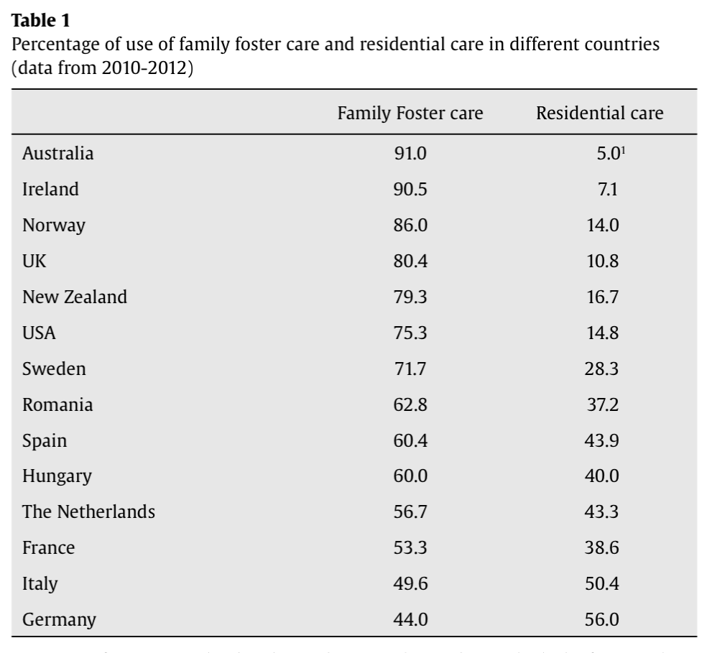
Family foster care vs. residential care
39.6

Slide 11
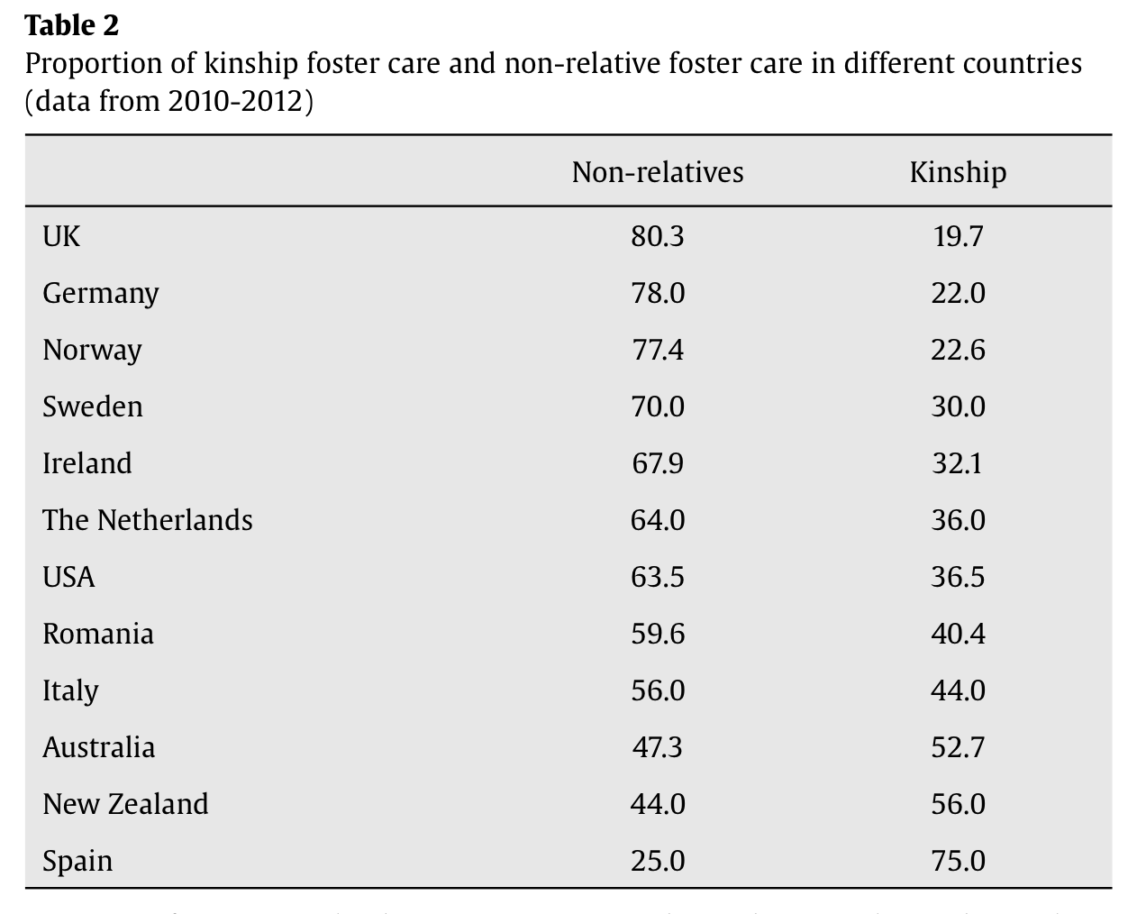
Kinship care vs. non-relative foster care

Slide 12
Evolution of Adoption in Spain

Slide 13
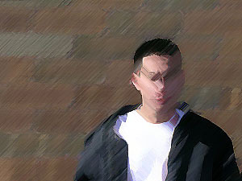
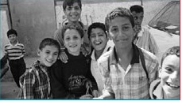
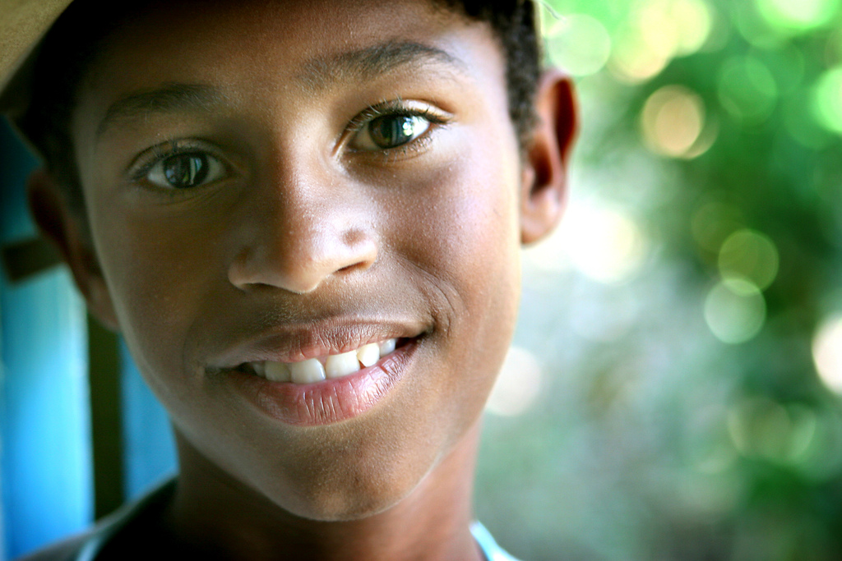
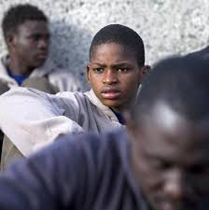
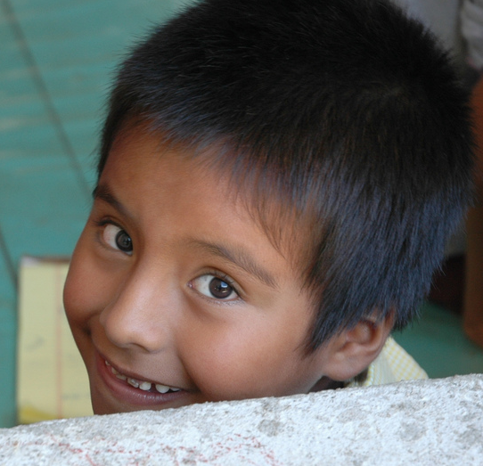
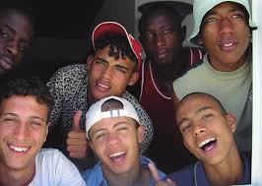
Unaccompanied Immigrant Minors

Slide 14
Definition
Children and adolescents under 18 years of age, third-country nationals, who are in the receiving country without the protection of a family member or responsible adult who habitually takes charge of their care, either legally or in accordance with the customs and traditions
(Resolution of the Council of Europe, 1997)

Slide 15
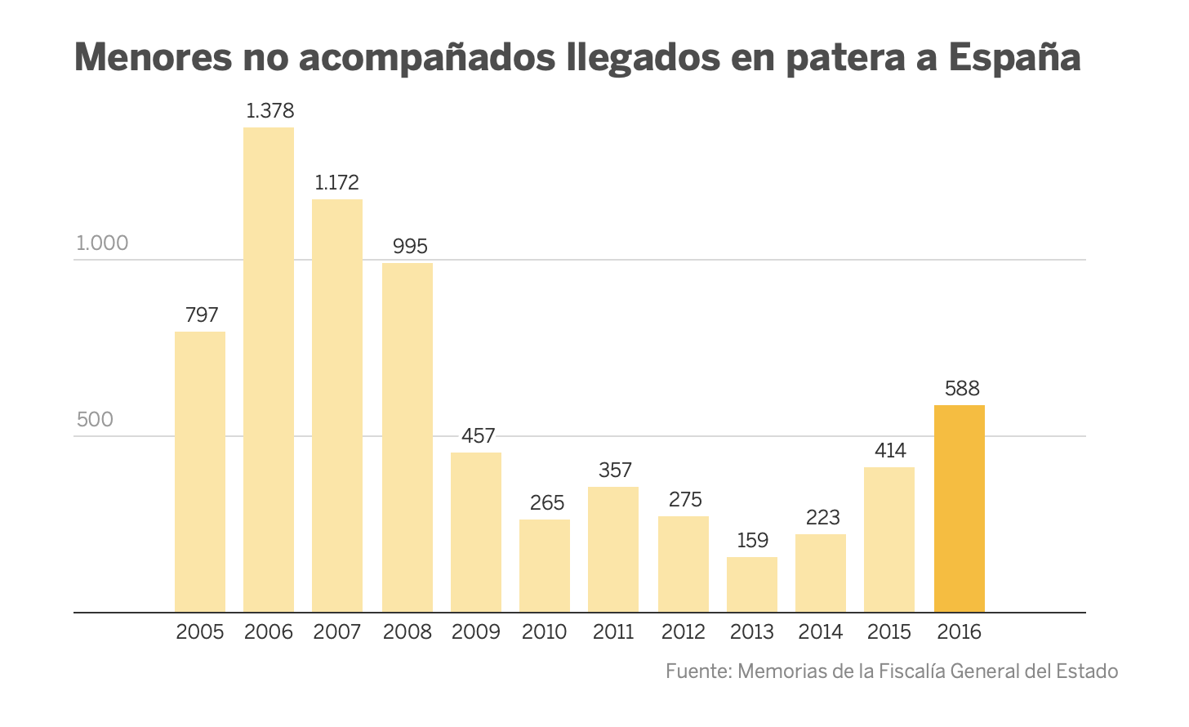
6,063 in 2018
2,345 in 2017
95% Males
94% Residential care
56% Morocco
20% Algeria

Slide 17
Intervention: They are not asylum seekers
Protected in terms of GUARDIANSHIP like “abandoned children”
Very often PROVISIONAL GUARDIANSHIP until verifying the age (if they don’t have documentation: radiological test)
Residential care: big specific emergency shelter care centres were open
Then, they are usually referred to residential facilities for adolescents in transition to adulthood
5% family foster care (usually with relatives or families from the same country)

Slide 18
Procedures
Minority of age confirmed and without possibility of repatriation: GUARDIANSHIP AND RESIDENCE PERMISSION
  Usually to some small residential home for adolescent in transition to be trained for independent living
In case of doubts of age: radiological test (it can take months…) and permanency in emergency care

Slide 19
¿Who are they?
Adolescents, mostly between 15 and 17 years old
95% boys
Moroccans and Algerians (80%); Sub-Saharan States, Eastern Europe and Asia

Slide 20
¿How do they arrive in Spain?
Small boats to the coast (Canary Islands, Andalusia)
Hidden in the base of trucks (very dangerous) crossing by ferry
Jet ski (more expensive: 6.000 €)

Slide 21
Resources
Coverage problems in some regions: Saturation
Creation of a double network: natives and immigrants
Emergency residential care
A model of high structuring and specialization is consolidated
Some foreign staff (Morocco…)
Learning Spanish as a priority
Start of training courses (even within the residential facility)
Start of documentation management
Enrollment in educational system (<16 years) or job training (specific courses)
Once the child's documentation has been collected (in origin), GUARDIANSHIP and application for the residence permit are processed
After guardianship they are referred to a stable residential facility
Lack of places in all regions during last years

Slide 22
Sample of 41 Interviews in Basque Country
Age: M= 16.8
Gender: 95% Males
Origin: 70% Morocco; 10% Algerie; Gambia, Ghana, etc.
60% in residential care in other regions previously
Average stay in this region: 12.8 months
48% had been living on the street as homeless at some moment
Time to get the age radiological test: 3-5 months

Slide 23
Types of residential facility
  48% Emergency care
  5% Children’s homes (the youngest)
  33% Transition to adulthood homes
  14% Therapeutic residential care (severe behavioural disorders)

Slide 24
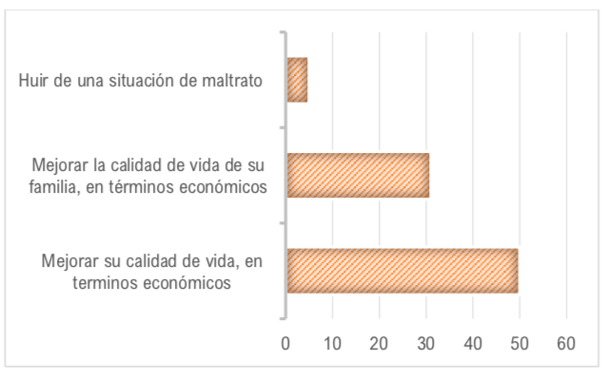
Main reason for migration
Flee from family abuse
Improving the family economic situation
Improving their own situation looking for a personal future

Slide 25
Economic migration
No one works in my family. My father is sick and my sisters can not work.
Among all of my house we put together 5 euros a week to live.
I work on what I can: selling things, helping my father, ... My sisters work rolling yarn.

Slide 26
Some have family references
Abdelrrahim, a minor with a lot of family in our country, in different cities, and therefore indirectly aware of the possibilities that can be accessed here.
He teaches us as something positive a sheet of paper that he carries in his wallet with usual words in Spanish and Arabic, numbers, interrogative particles, etc., and next to his approximate pronunciation in our language but written in Arabic characters.
He always appears as a collaborator in the environment that surrounds him.

Slide 27
Others are street children
Said, a native of the town of Tangier, from where he says he arrived inside the box of the bottom of a truck. He has certain symptoms of malnutrition and states that he lived only with his mother since his father left when he was little. He spent most of the day alone, down the street, and has been in school only the first years of primary school.
After he left and has been in the street doing various mechanical or carpentry works until he started to go on his own betunero account. His knowledge of the different brands of glue testifies that he spent several years snorting. One fine day, together with a friend, he decided to come to Spain.
His mother does not know where he was at the time of reaching the center.

Slide 28
Some important factors
Image of success transmitted by the emigrants themselves to their family and friends
Who is a bit smart goes to Europe, I know many people who have left and who have managed to improve their situation…
Climate of opulence influenced by the media
I saw on TV what Europe was like and I wanted to be like them, that's the truth…
Promise of freedom, work and fun
The friends of France with whom I keep in contact make a good living and at the same time they can do whatever they want…
There in Europe if you try hard you can succeed, it's a land of freedom and you can also live youth without the prohibitions and hypocrisy here ...

Slide 29
Family contact
93% have contact with their family
  57% weekly
  30,2% daily
Crucial aspect due to pressure for success from family
Frequent reason for emotional problems as well as clashing with the reality after so high expectations

Slide 30
Percentage of GOOD evaluations about their residential facilities

Slide 31
Child Behavioural Checklist
40,4% rango clínico
60,4% rango clínico
(externalizante/internalizante y/o total)
50,8

Slide 32
Personal Wellbeing Scale
10=completely satisfied
0= completely dissatisfied

Slide 33
Transition to adulthood
Training for employment: priority in their intervention plan
Examples of good practice: specific support programs for housing, labor market integration, educational and psychological monitoring, legal advice and financial support for migrant children aged 16 to 21
But ... big differences between regions in terms of availability of this kind of resources

Slide 34
Who is out of the circuit? ”Without protection
Young people near the age majority afraid of being transferred (expulsion) to their country
Conflicts in residential facilities and living on the streets
Serious risk of illegal activities
Community social services

Slide 35
Conclusions
The massive arrival of immigrant minors is defined like a “tsunami”
The old model of large institutions had to be used again as emergency care
Great conflict between protection laws (very protective) and immigration laws (very demanding to obtain work permits)
Social alarm due to its high number, presence in small towns, stereotypes ...
A lot of emotional problems: expectations vs reality, cultural adaptation, etc.

Slide 36
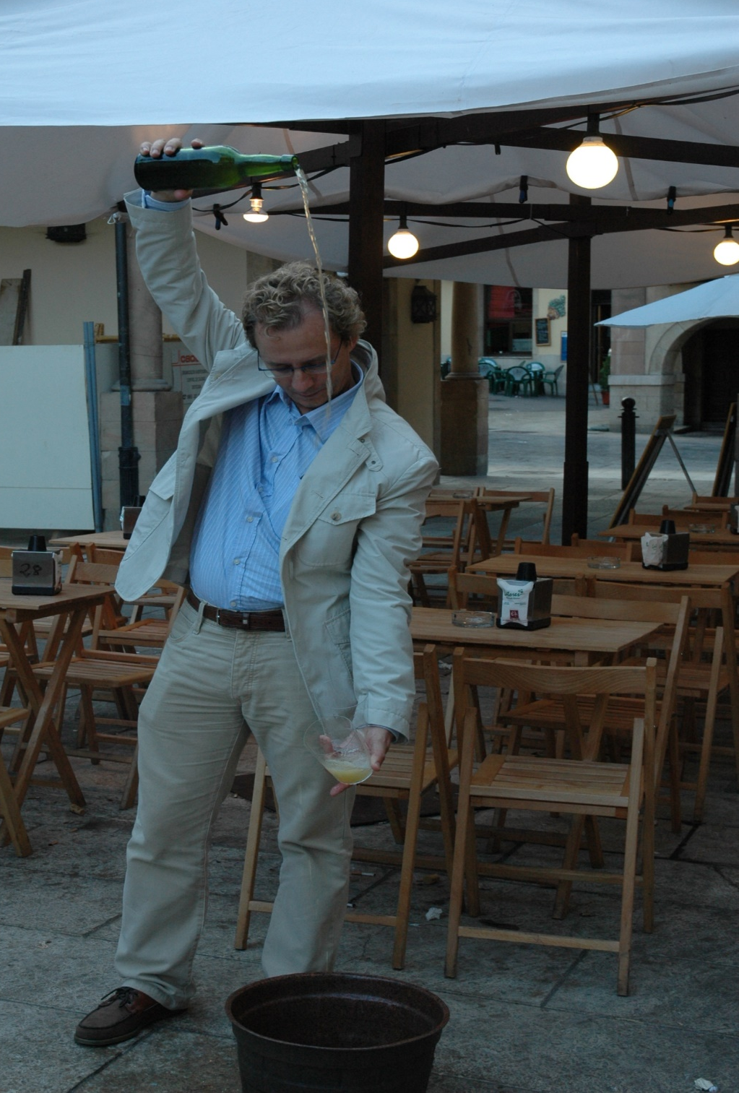

Thank you!!
www.grupogifi.com
jvalle@uniovi.es

